Slide 1

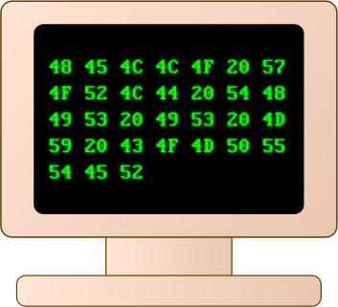

MA1 – A Microprogrammed Machine
COMP 256 – Dickinson College
Prof. Braught
Spring 2023
Images from: openclipart.org

Slide 2

Machine Abstractions
General purpose programmable computers can be understood as an abstraction hierarchy:
Physical Machine
Microprogram Machine
Machine Language Machine
Assembly Language Machine
High-Level Language Machine
There are also several important architectural abstractions:
The Stored Program Architecture
The Instruction Cycle (Fetch/Decode/Execute)
Memory Hierarchy & Cache
Pipelining and Parallelism
Photo by: Steven Gerner, https://www.flickr.com/photos/sgerner/16477700444/in/photostream/
Used under a Creative Commons by-sa 2.0 license: https://creativecommons.org/licenses/by-sa/2.0/
Notes:
Today we start a new unit on Machine Abstractions
- In a nutshell, this unit addresses how do we go from manually programmable circuits (like lab 3) to a general purpose programmable computer.
We get there through layers of abstraction in a hierarchy
- we have seen the physical machine
- from electrical voltages to 0-1, to transistors, go gates, to circuits,
- to the programmable circuit from lab 3 where we instructed it with 0’s and 1’s to perform different computations.
- In this unit we will look at
- A Microprogram machine
- A machine that is programmable with 0’s and 1’s that directly correspond to its configuration.
- A Machine language machine – still programming with 0’s and 1’s but at a higher level of abstraction
- Where the 0’s and 1’s will correspond to operations that we want to perform
- rather than how the machine is configured.
We will also see some higher level abstractions that capture important organizational (architectural) principles of how modern machines are built.

Slide 3
Early Electronic Computers
Early electronic computers were not general purpose.
“Programming” required physical rewiring and setting knobs and switches to create a machine that performed the desired computational task.
Colossus – 1945
Tommy Flowers, Bletchley Park, UK
ENIAC – 1945
John Mauchly, J. Presper Eckert, Penn
Notes:
I used the term “genera purpose programmable computer” on the previous slide.
I did that to differentiate from earlier computers that were not general purpose.
They were built or could be rewired to perform specific computations.
They could not be programmed to do different things.
If you wanted a different computation your reconfigured the machine physically.
That physical rewiring…
- Like building a bunch of circuits like those from lab 3 but more complicated so they can operate on 8 or 16 or 32 bit values.
- Each circuit computes a particular set of functions (e.g. NOT, OR, AND, PLUS)
- each circuit was set to perform one of the operations as appropriate to the problem being solved.
- the output of each circuit was then connected to the inputs of the next
- to perform a sequence of operations
- i.e. a program.
Several of the earliest ones emerged at about the same time in the UK and the US.
You’ll have the opportunity to learn more about these machines and a few others in a video in the activities.

Slide 4
The Knob and Switch Computer
Data Path
Registers (R0-R3)
Busses (A, B, C)
Arithmetic and Logic Unit
ALU
Notes:
We are going to work with The Knob & Switch Computer
- it is a model of a small computer
- but it is organized based on the same principles as modern computers
- but let’s us see what is happening inside as it performs its computations.
- and it allows us to interact with it directly.
- We will use it to build experience and intuition about how computers are organized and how they process information.
- Ultimately, it will help us understand how a computer can be programmed with 0’s and 1’s.
The main structure in the K&S is called the data path.
It consists of 3 main elements:
- Registers: Temporary storage for values used in the machine’s calculations
- Here we have 4 registers
- An actual computer will have many more (16, 23, 64, 128 or more).
- Busses: wires that connect the different components and allow the electrical signals to move between them.
- The text boxes in the K&S show us what is on the bus
- In an actual computer there is no way to see this because the busses are just wires.
- ALU: Performs the actual computations
- Addition, OR, AND, Subtraction
- An ALU in an actual machine would perform many more operations.

Slide 5
The Knob and Switch Computer Data Path
https://dickinson-comp256.github.io/Knob-And-Switch-Computer/datapath.html
DEMO!
Notes:
Short demo of how the K&S data path works and how we can interact with it.
Type in some values
- use small positive and negative values
- use positives that are easily verifiable in two’s complement by hand
Click some knobs to choose registers and operations.
Setup and execute an operation:
- R2 = R0 + R1
- Talk through the animation.
- Change the animation speed.
Change to Base 2 and check values.
- Notice that each register holds 16 bits.
- The +-10 setting tells the K&S to use 16-bit two’s complement representation.
- You may need to change font size in your browser to see the full 16 bits
- The default font in some browsers results in a few bits being hidden.
- Making the font size smaller will show them.

Slide 6

Try It!
https://dickinson-comp256.github.io/Knob-And-Switch-Computer/datapath.html
Enter the values 100, 110, 225, 515 into R0-R3.
Set up and execute the data path to perform the following operations:
Double the value in R0 an put it into R1.
Set the value of R3 to 0.
Assuming R3 holds 0, change the value in R2 to be its complement (i.e. -225).
Set the value of R3 to be 7 times the value in R1 (i.e. 700).
Can you do it in 4 steps?
Work in pairs to use the settings in the Knob & Switch Data Path to perform these tasks.
Notes:
Work on these for a little while.
Have a report out on ideas and questions.
Leave enough time (~15 minutes) cover the rest of the materials.

Slide 7
Knob and Switch Computer with Main Memory
Main Memory (RAM)
Memory Locations
16-bit values
32 locations
5-bit addresses
Unsigned binary
Switches
Notes:
In the homework you will work with two more versions of the K&S computer.
- These are a sequence of simple machines
- Each adds a little more complexity and a little more power.
- The idea is that they build up to a full picture of approximately how a modern computer works.
The first of these two is the K&S with Main Memory.
The big change is that this machine has a Main Memory:
- The 4 Storage locations provided by the registers are not much.
- We would need more than that to perform any significant computations.
- The main memory provides that additional storage.
- This main memory is the RAM
The K&S’s Main Memory is pretty small (32 locations)
- This is as compared to the 4, 8, 16 + GB that you have.
- A giga is about 1 billion so 4, 8 or 16 billion locations
- But the idea here is exactly the same.
- The K&S just keeps it small so it can be visualized for us.
Every location in the K&S Main Memory
- holds 16 bits (same as the registers)
- has an address so that we can refer to it.
- addresses are 5-bits long in unsigned binary
- Can also see in base 10.
We use the switches to change how data moves.
- move from registers to registers (as before)
- Move from memory to registers
- Move from registers to memory (through the ALU)
Be careful not to connect two inputs to C-Bus at the same time.
- Data collision – bad news… corrupted results.

Slide 8
Programming the K&S?
How might we write program instructions for the K&S using only 1’s and 0’s?
Notes:
Do a little brainstorming.
No need to get it exactly right.
We just want to get some ideas out here.
The exact details will come out in the homework.

Slide 9
The Knob and Switch Computer (v3)
Microinstructions are an abstraction for the machine configuration.
0’s and 1’s encode the knob and switch positions and the memory RW address.
A micro-program is a sequence of micro-instructions.
Notes:
Now we can think about programming the machine using 1’s and 0’s instead of switches and knobs.
- We just need to agree on a way to encode the configuration of the data path.
- the position of each knob:
- The K&S uses 00 = up, 01 = right, 10 = down, 11 = left
- the state of each switch
- The K&S uses 0 = open, 1 = closed
- Going counter clockwise starting from the top switch (Between the C Bus to Registers)
- the memory location to be used
- The K&S uses 5-bit unsigned binary.
Once we agree on that, we can write down machine configurations as a series of 1’s and 0’s.
- We can then write down a sequence of those configurations
- The machine will execute them one after the other.
- That’s a program!
(Set one up in advance and run it just to see it go)

Slide 10

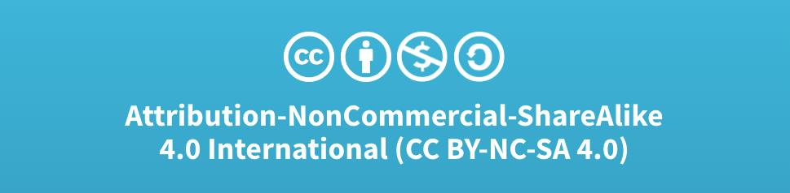
Acknowledgments
Slide Template From:
https://creativecommons.org/licenses/by/4.0/
Slide Content Licensed as:
Creative Commons Attribution-NonCommercial-ShareAlike 4.0 International License.
Notes:
Note: Individual images may be covered by their own licensing agreements and were incorporated here under fair use. Their use in this slide deck does not change or alter their licensing.

Slide 11
The Knob and Switch Computer (v1)
Data Path
Registers (R0-R3)
Busses (A, B, C)
Arithmetic and Logic Unit
ALU
Number Base
Notes:
Can display the contents of the machine in a variety of different representations.

Slide 12
The Knob and Switch Computer (v1)
Data Path
Registers (R0-R3)
16 bit values (word size)
Busses (A, B, C)
Arithmetic and Logic Unit
ALU
Number Base
+- 10 (Two’s Complement)
10 (Unsigned Binary)
2 (Show the bits)
Notes:
See that Registers hold 16 bits:
- 16 bits vs 64 bit machine
The

